Slide 1
Final Presentation﻿ PPT
Team member: 任辉、夏康杰、黄磊

Slide 2
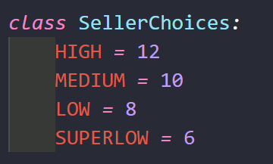
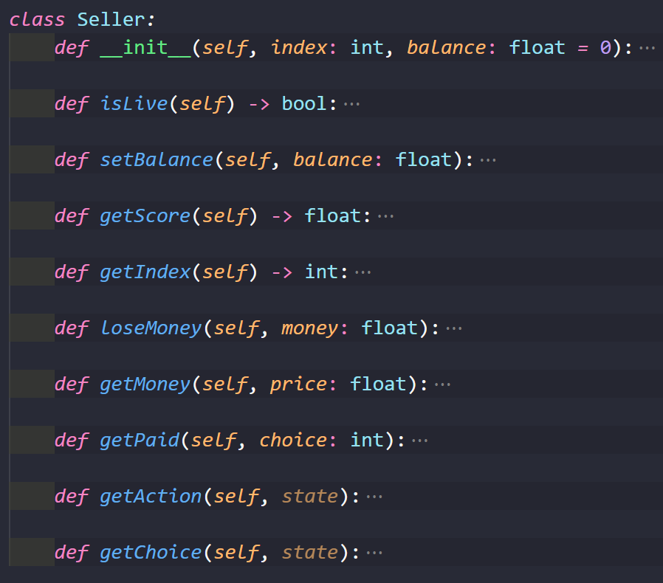
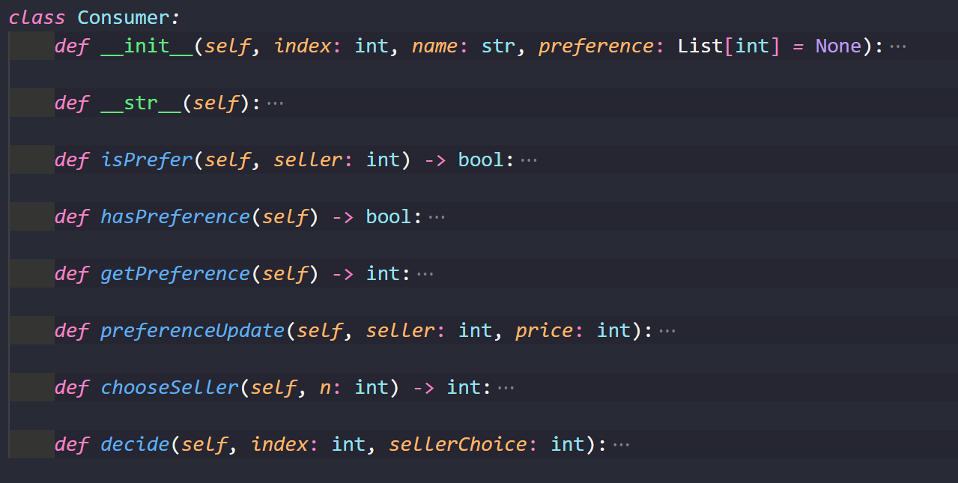
Realization: Seller And Consumer

Slide 3
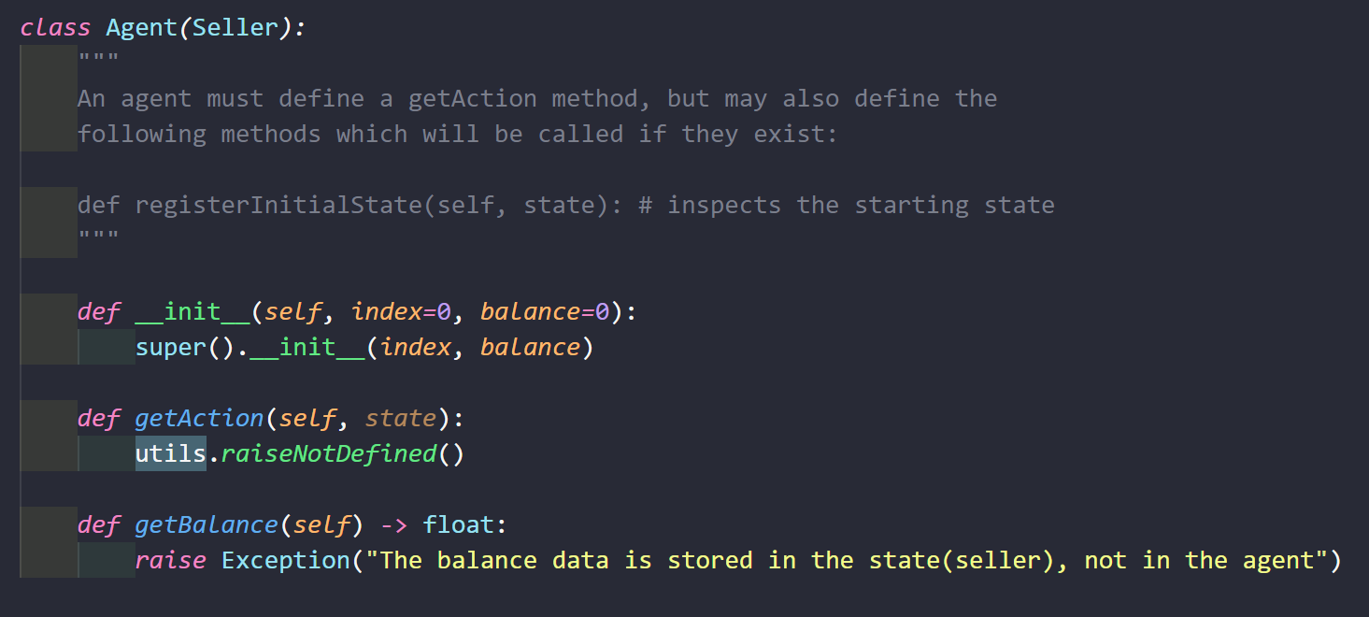
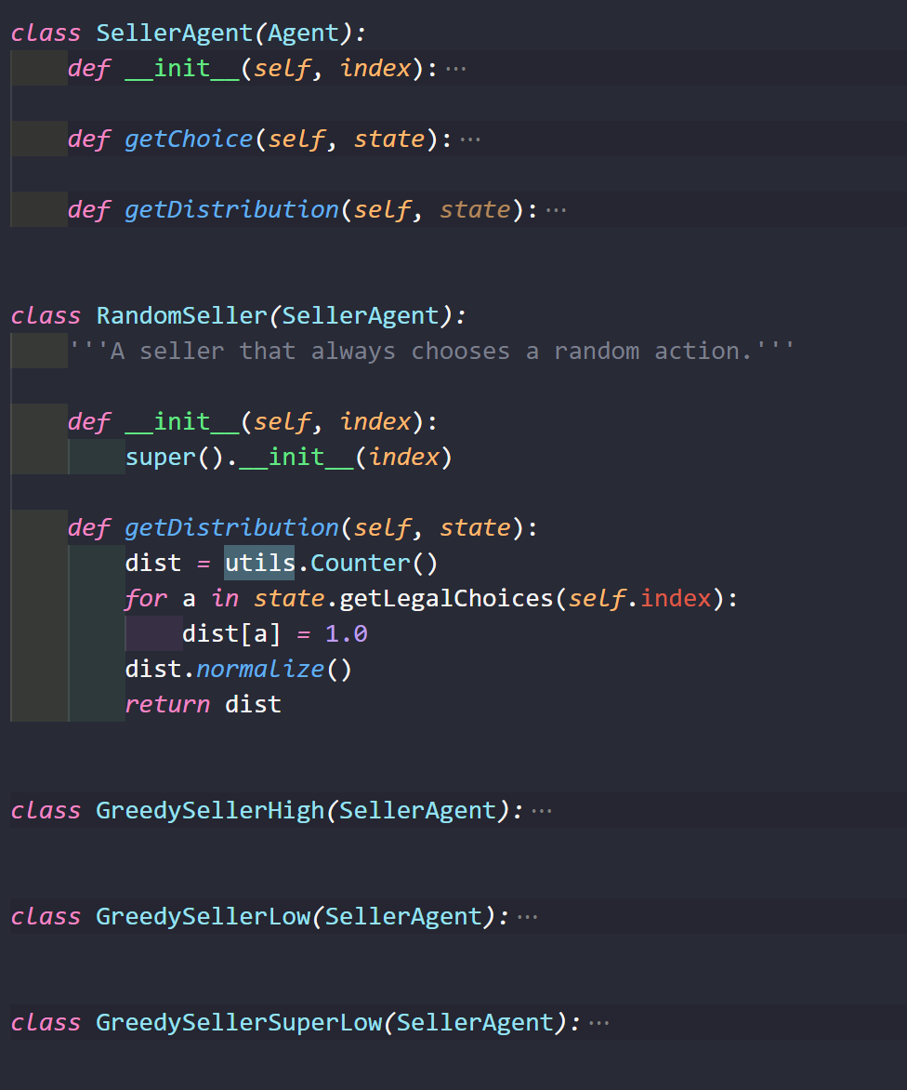
Realization: Seller And Consumer

Slide 4
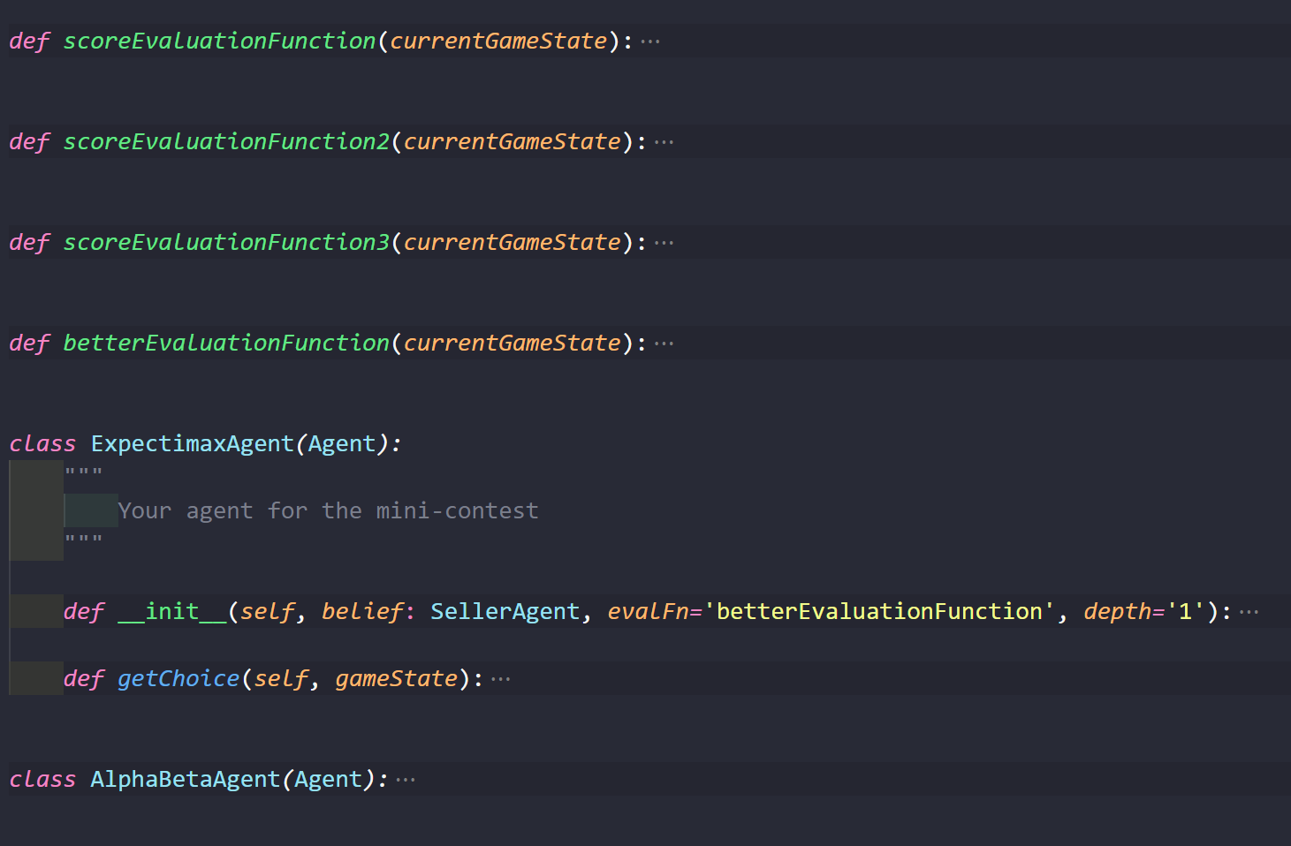
Realization: Tree Search

Slide 5
Realization: Reinforcement Learning

Slide 6
Comparison

Slide 7
Output

Slide 8
Contribution

